Slide 1

EMPOWERING STUDENTS. TRANSFORMING CAREERS
ProgMaster Pvt Ltd – Training & Placement Division
From Basics to Dream Jobs

Slide 2

INTRODUCING PROGMASTER
Building Careers from the Ground Up
We believe every student deserves a chance to shine.
Over 3240+ learners trained across India in from Jan 2025 - Oct 2025.
Focused on training + lifetime placement support.

Slide 3


WHY CAREER TRAINING MATTERS
Bridges gap between college education & industry expectations.
Creates job-ready candidates for top MNCs.
Boosts confidence, communication & employability.
Quote:
“Skill is the new degree.” – ProgMaster Vision

Slide 4
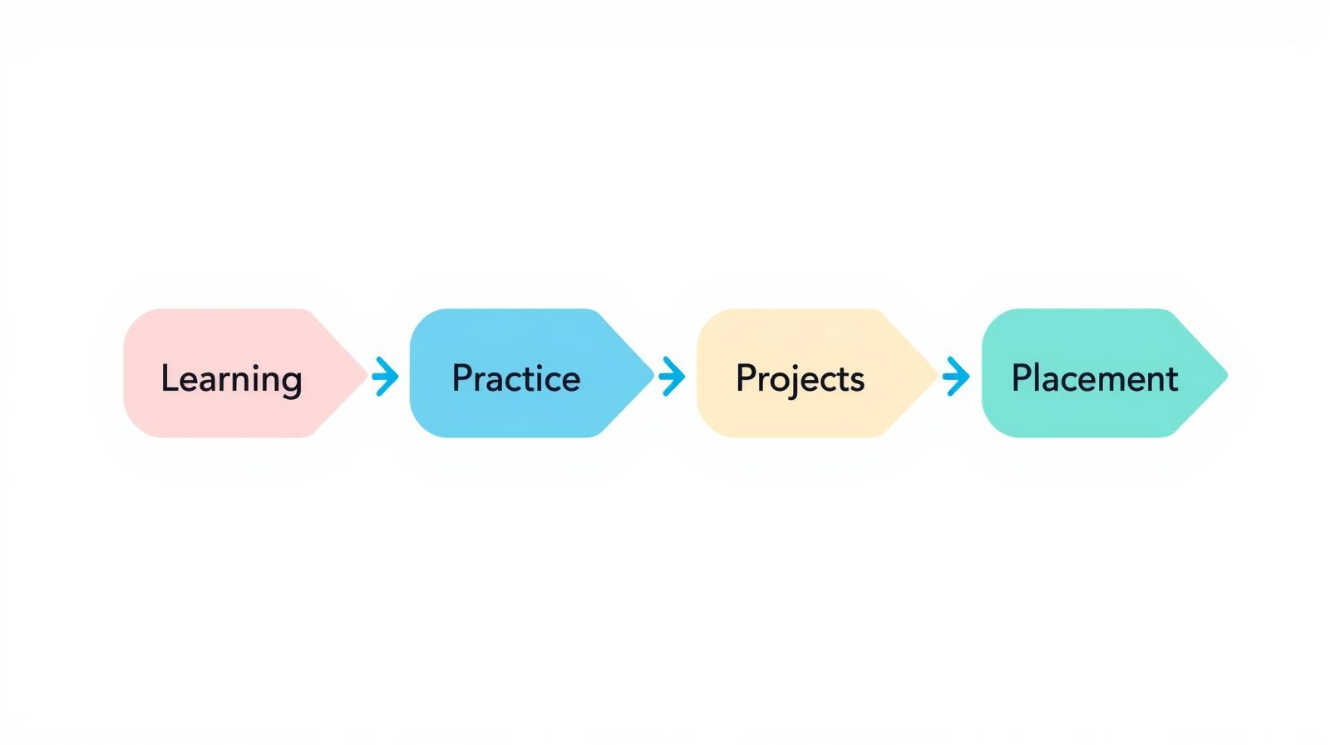
OUR TRAINING
PROCESS
Learn. Practice. Get Placed.
Basics to advanced coding & technical skills.
Real-time projects & case studies.
Soft skills & resume preparation.
Mock interviews with MNC professionals.

Slide 5





THE 5 PILLARS OF SERVICE EXCELLENCE
Empathy
Professionalism
Responsiveness
Ownership
Consistency
Truly understand the customer
Be respectful and knowledgeable
Act quickly and efficiently
Take responsibility until resolved
Deliver quality every time

Slide 6
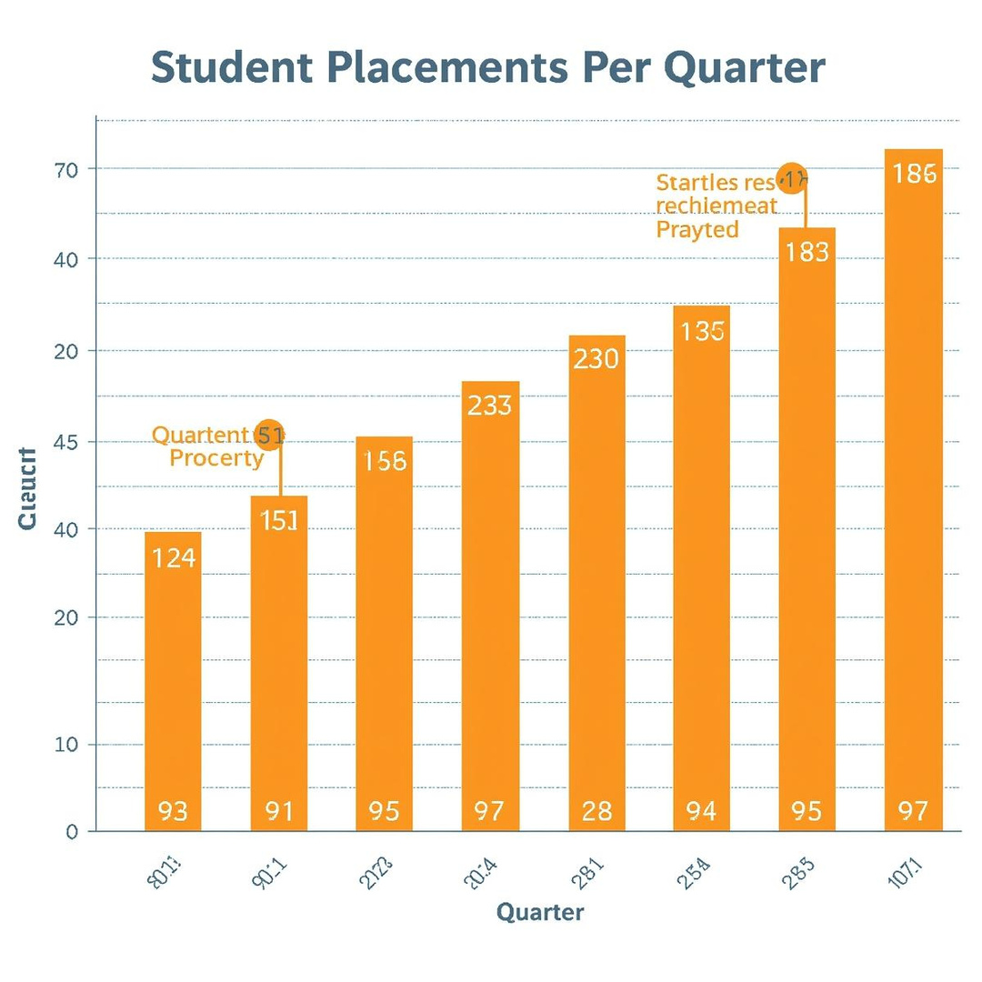
PLACEMENT SUCCESS OVERVIEW
Turning Learners into Professionals
🎓 3240+ Students Trained
💼 1987+ Students Placed in Diff Companies
💰 3.5 LPA – 9.5 LPA Packages (Freshers)

Slide 7






OUR INDIRECT CORPORATE PARTNERS
Trusted by Leading Companies
And so on.................

Slide 8

LIFETIME SUPPORT PROMISE
We Never Stop Supporting You
100% job referral support.
Not limited to 6 months or 1 year —
support continues until placement.
Resume updates & interview alerts.

Slide 9

WHY CHOOSE PROGMASTER?

Slide 10
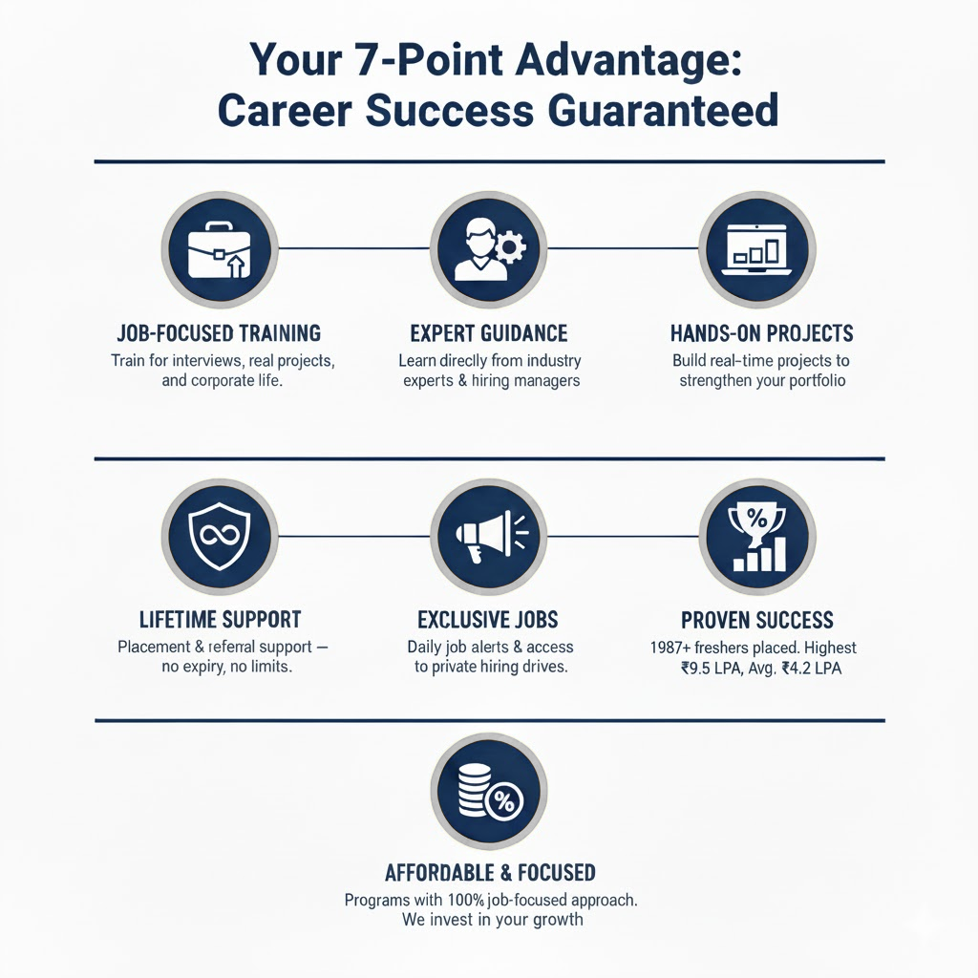

Slide 11




THANK YOU FOR YOUR TIME
CONTACT US
tech@progmaster.in
progmaster.in
+91 7993854229
@progmaster
Presented by PROGMASTER PVT LTD

